Slide 1
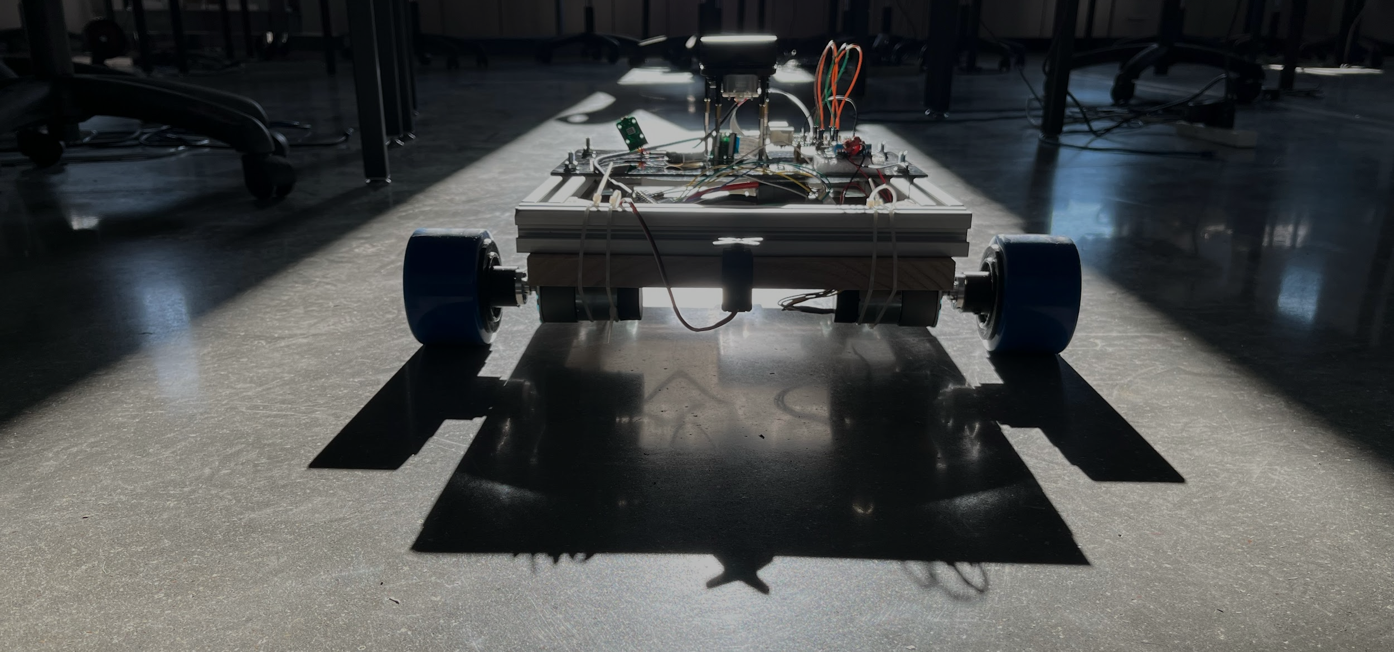
Brandon Donaldson
Austin Miller
Will Ward
THE
BOT-BROS

Slide 2
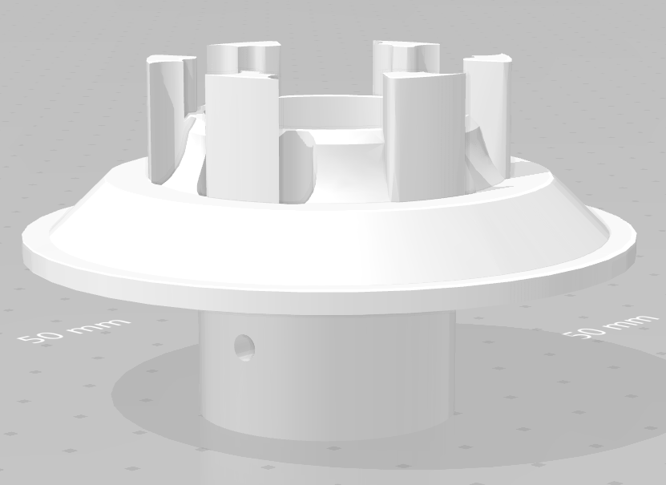
Design Process
Part Placement
Wheel and Motor Mounts
Logic Workflow

Slide 3
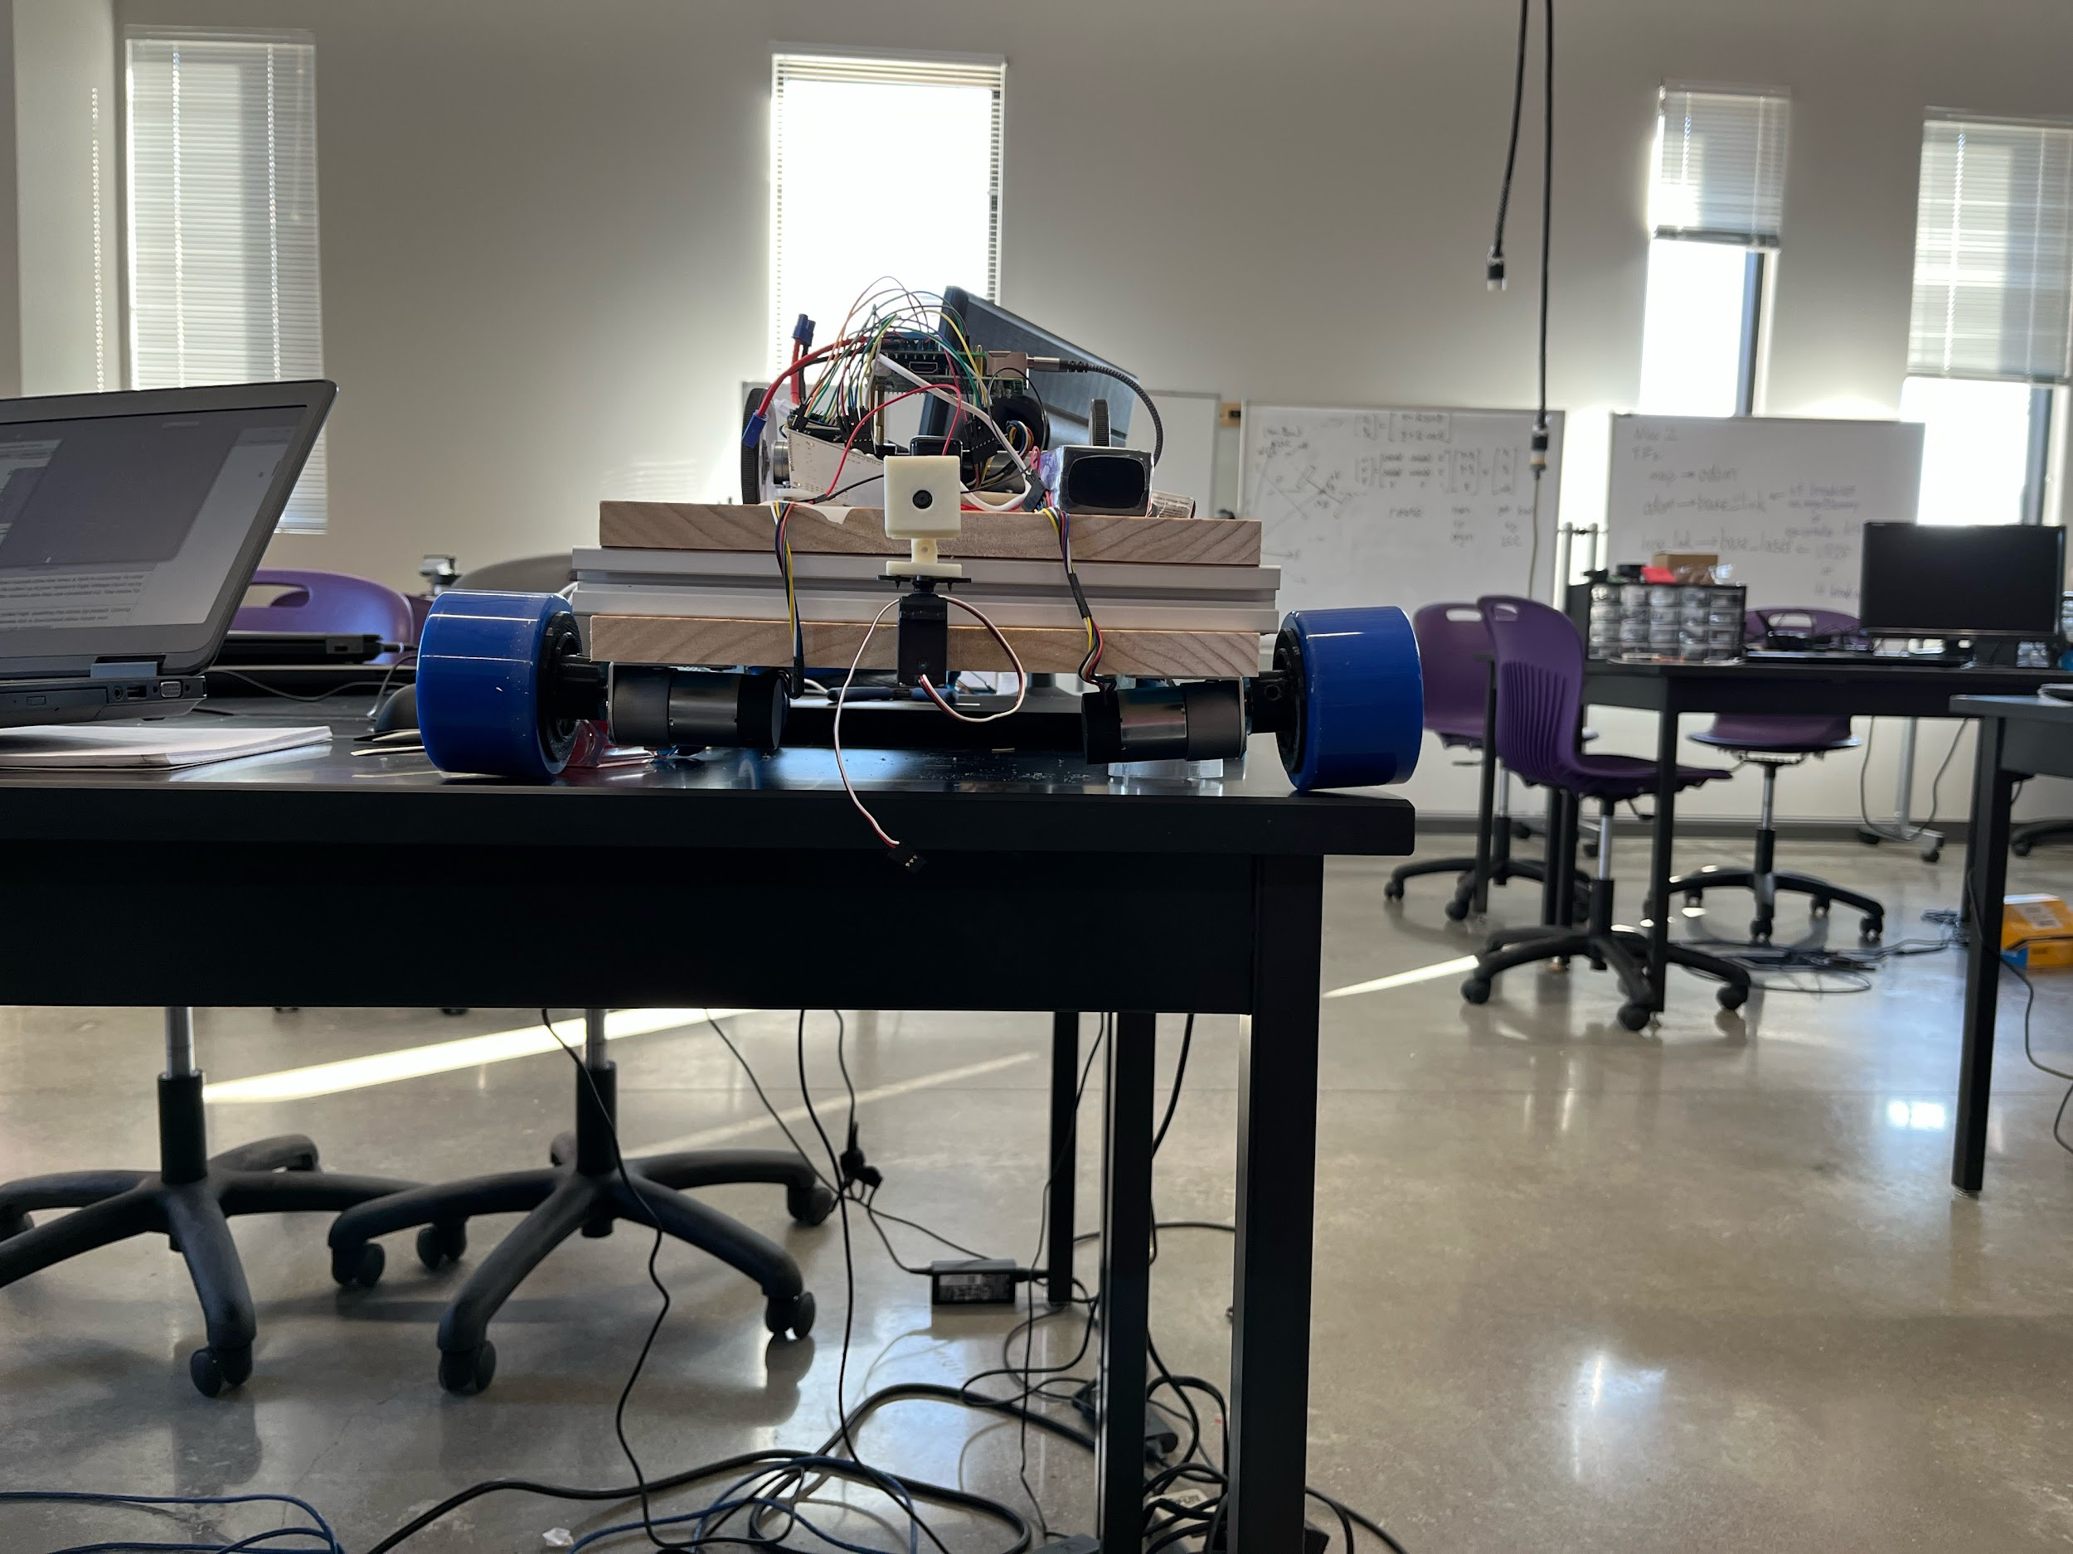

Slide 4
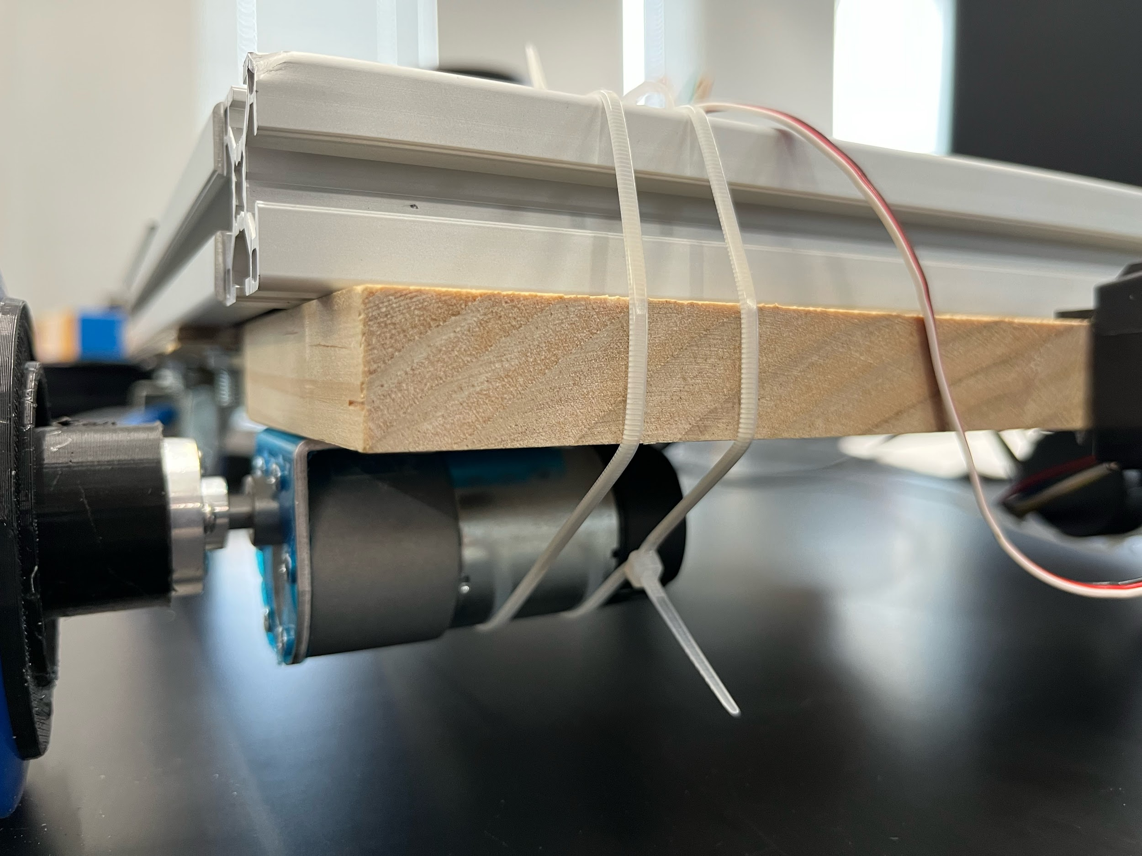

Slide 5
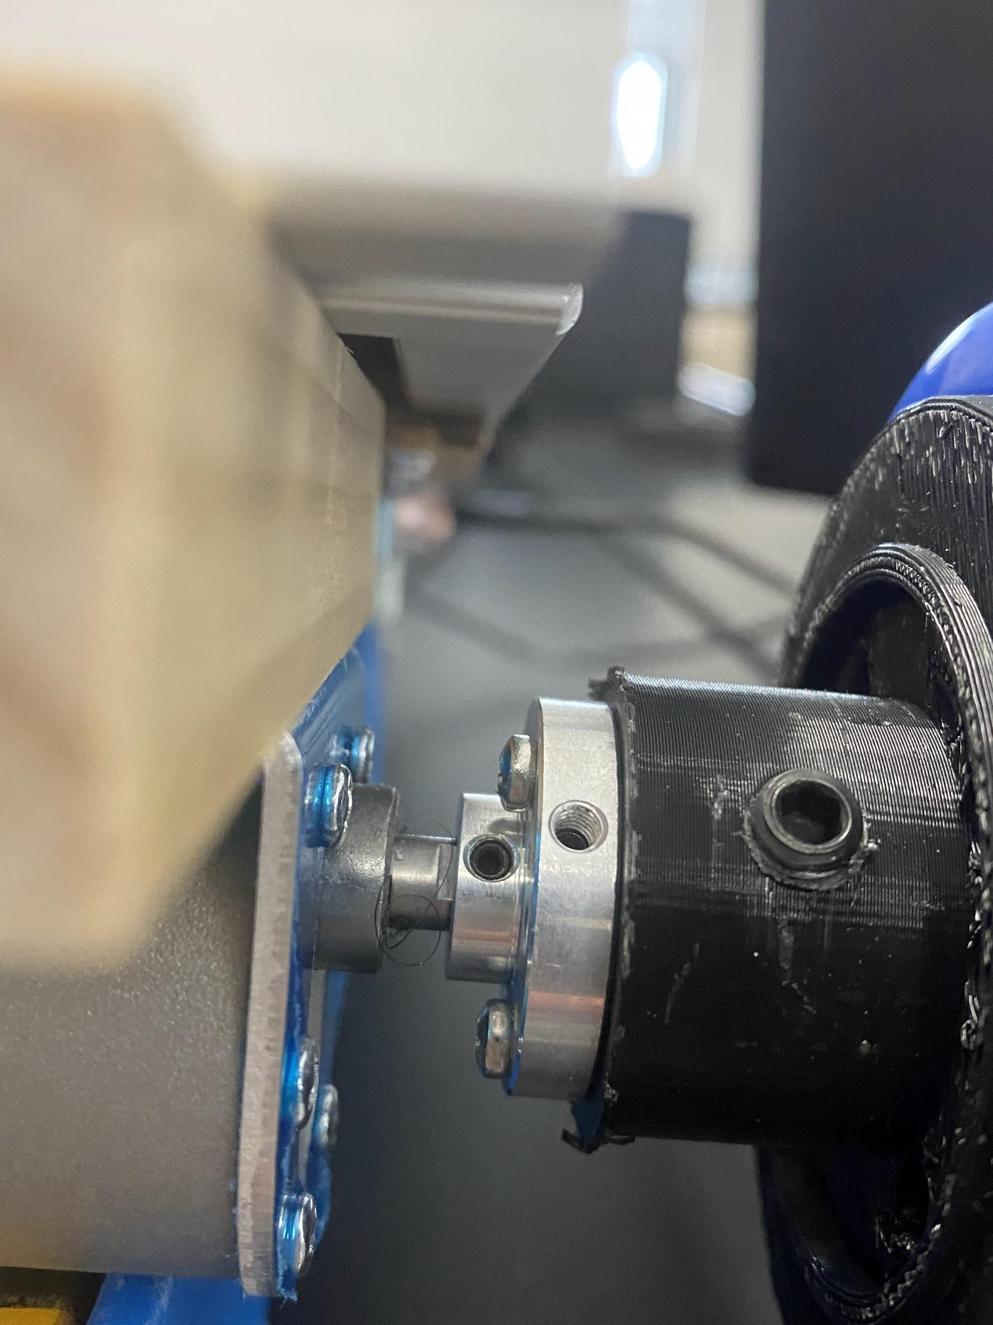

Slide 6
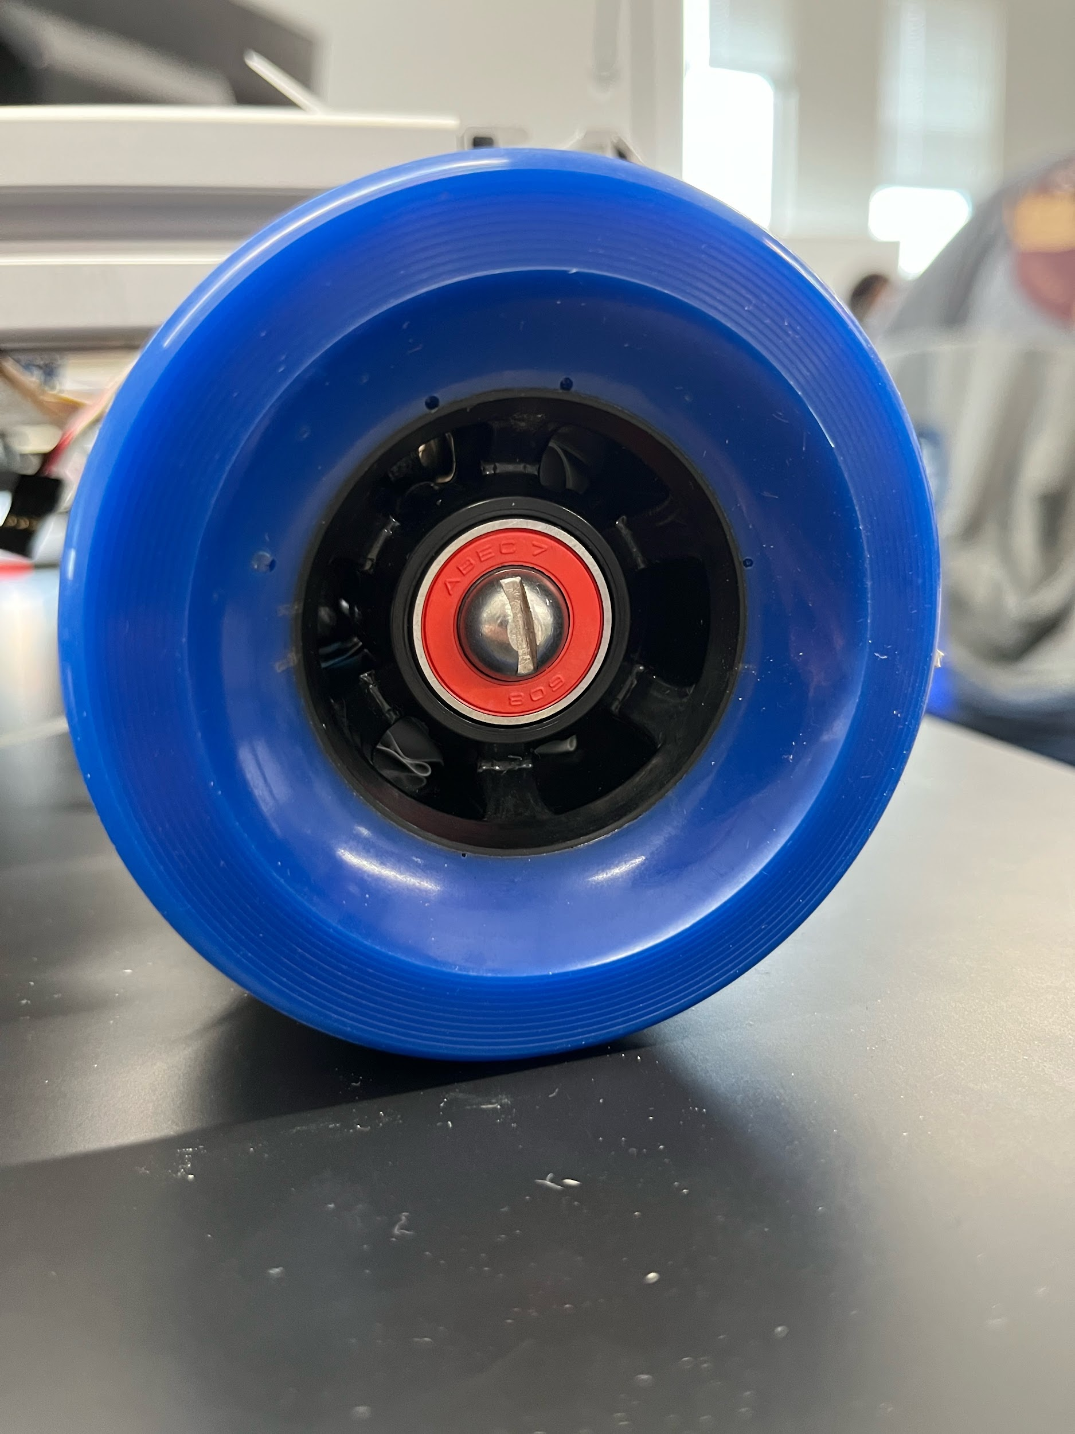

Slide 7
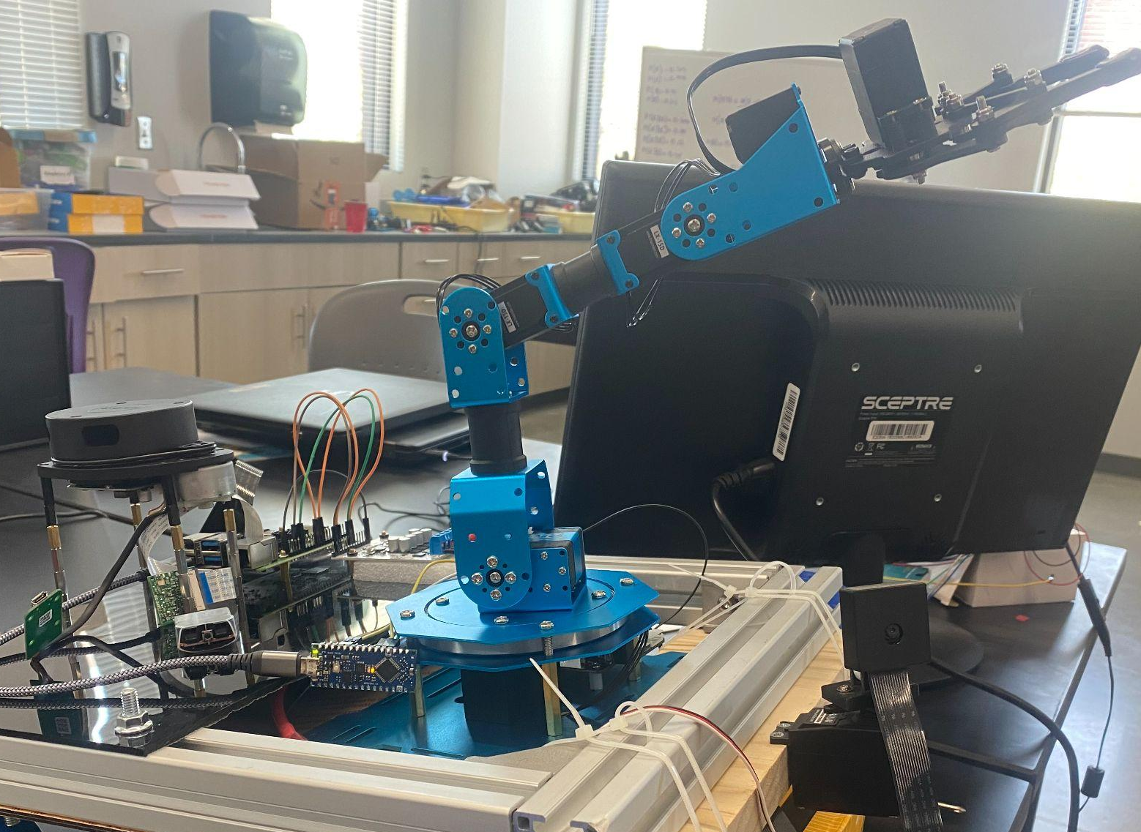
Hardware
Batteries
Raspberry Pi
Arduino Nano
Motor Driver
Future Hardware
Lidar
Robot Arm
Camera

Slide 8
ROS_DOMAIN_ID → Bridge For Communication
Nodes on the same domain can communicate with each other.
Publisher-subscriber
Publisher = teleop_twist_keyboard
Subscriber = ‘subscriber_member_function.py’
Robot is running ‘subscriber_member_function.py’ through ssh.
In separate terminal, laptop is publishing teleop_twist_keyboard commands
Robot and laptop are ‘connected’ via ROS_DOMAIN_ID
Can be set using following terminal command
echo "export ROS_DOMAIN_ID=<desired number>" >> ~/.bashrc
‘Echoing’ this command to ~/.bashrc removes the need to repeat the process every time a new shell is created.
Notes:
Reference: https://design.ros2.org/articles/ros_on_dds.html

Slide 9
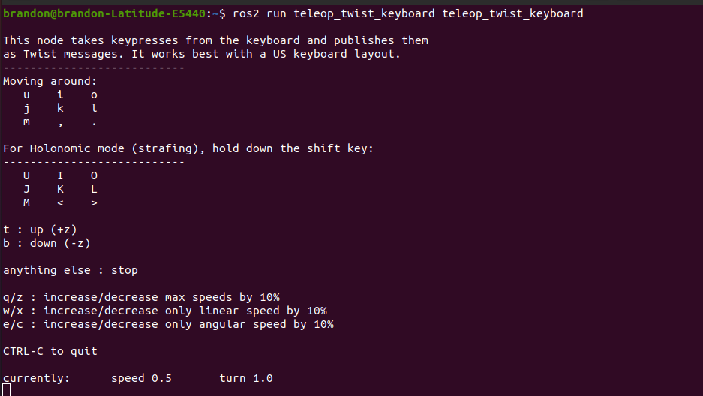
Teleop_twist_keyboard → Publisher
Notes:
-Teleop_twist_keyboard is a method of controlling a robot remotely using ros2
-our project does not utilize the “Holonomic mode” because our wheel setup doesn’t allow for strafing movements
- same applies for “t” and “b”
-DESCRIBE WHAT EACH LETTER CORRESPONDS TO REGARDING ROBOT MOVEMENT
I.e. ‘I’ →FORWARD, ‘K’ → STOP, etc.
-’q/z’, ‘w/x’, ‘e/c’ → adjusts robot velocity
Removes the need for coding in speed up/slow down functions, these keys will change the linear/angular velocity coefficients
**linear/angular velocity coefficients in code are 0.96 (96% max power) in subscriber_member_function.py

Slide 10
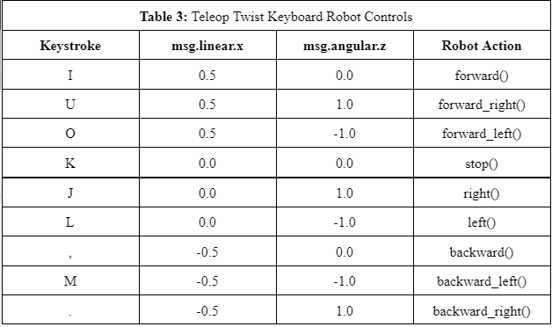

Slide 11
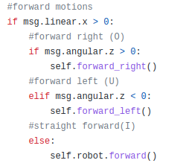
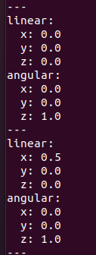
Subscriber Function
Listens to publisher node
Teleop_twist_keyboard → publisher
Keys controlling movement: ‘u’, ‘i’, ‘o’... etc.
When a key is pressed, velocity value changes are sent to /cmd_vel.
Subscriber function reacts accordingly…
Subscriber function reactions →
/cmd_vel →
Notes:
Terminal line: “ros2 topic echo /cmd_vel”
– teleop_twist_keyboard needs to be running in another terminal tab to see the /cmd_vel values

Slide 12
Node Graph
/teleop_twist_keyboard (NODE)
Button pressed
/cmd_vel (TOPIC)
Linear/Angular values changed
/minimal_subscriber (NODE)
Reacts to values changed and spins motors according to /cmd_vel Linear/Angular values

Slide 13
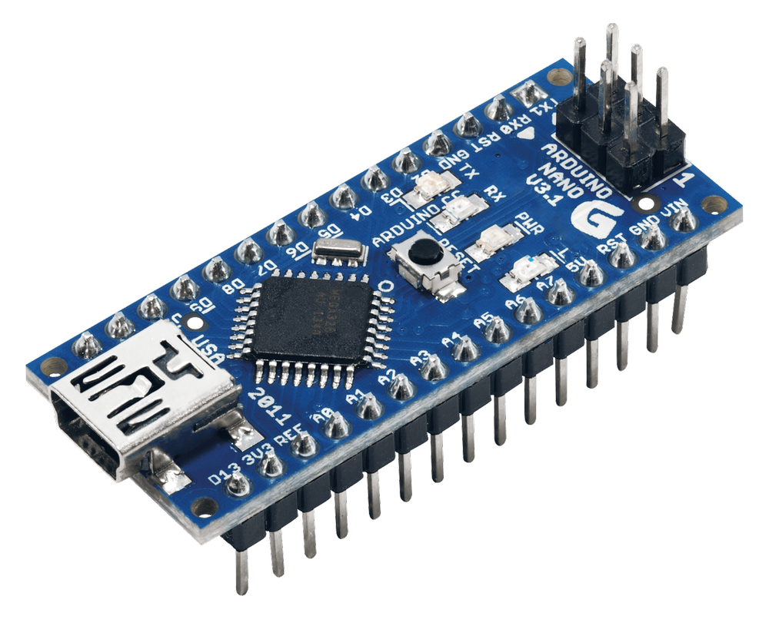
Encoder, Odometry, P Control
Arduino -- reads Encoder counts
linear speed = cps * 2**R / (CPR * gearRatio)
odom_listener.py
Read serial data --> publish L and R speed to /linear_stuff

Slide 14
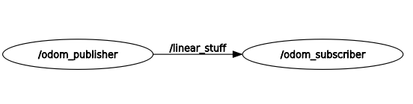
Encoder, Odometry, P Control
bot_testing.py
Subscribe to /linear_stuff --> compare to desired speed
p = 0.1
error = desired_speed - speed
pwm = pwm + p * error

Slide 15
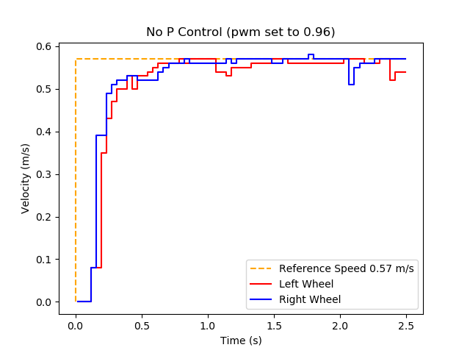
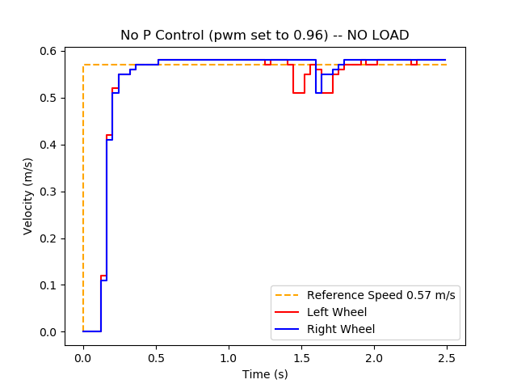
Motor Response Test

Slide 16
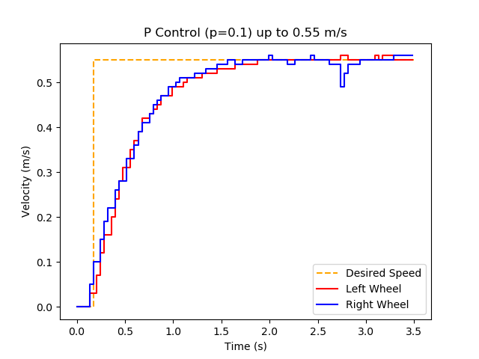
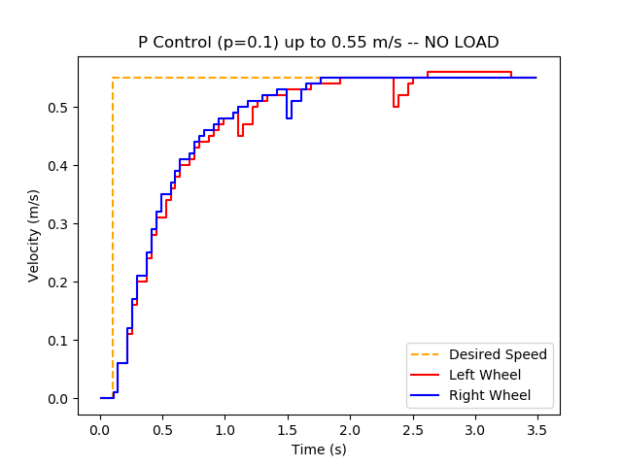
Proportional Gain Control Test (p=0.1)

Slide 17
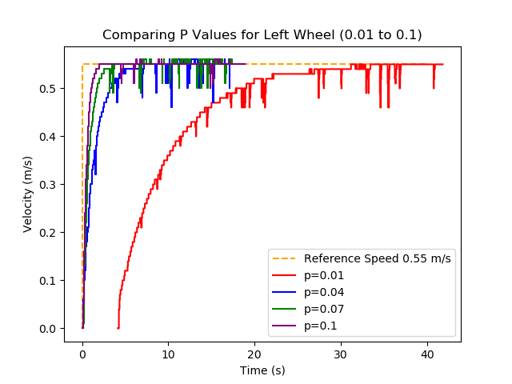
Notes:
NO LOAD

Slide 18
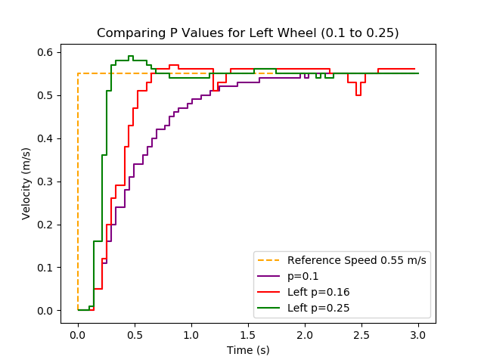
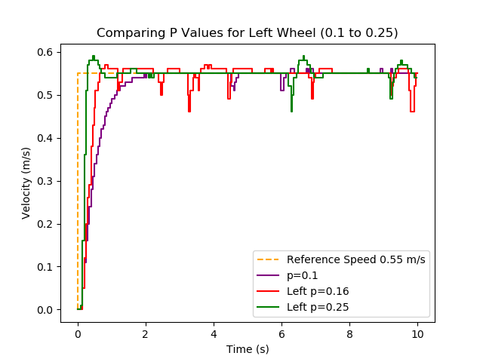
Notes:
NO LOAD

Slide 19
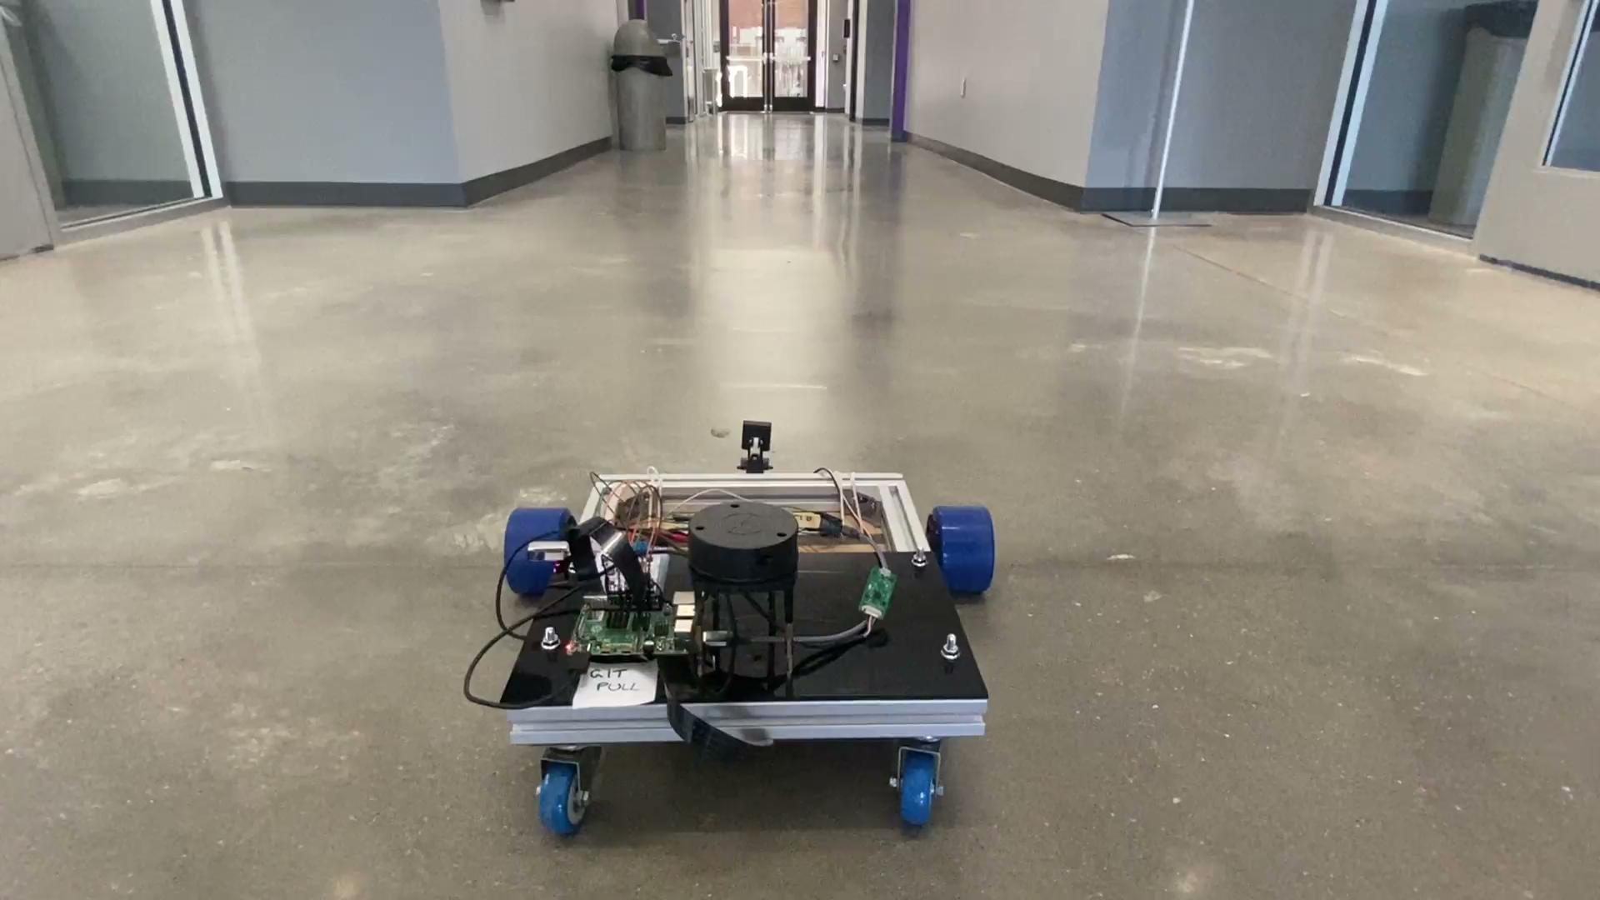

Slide 20
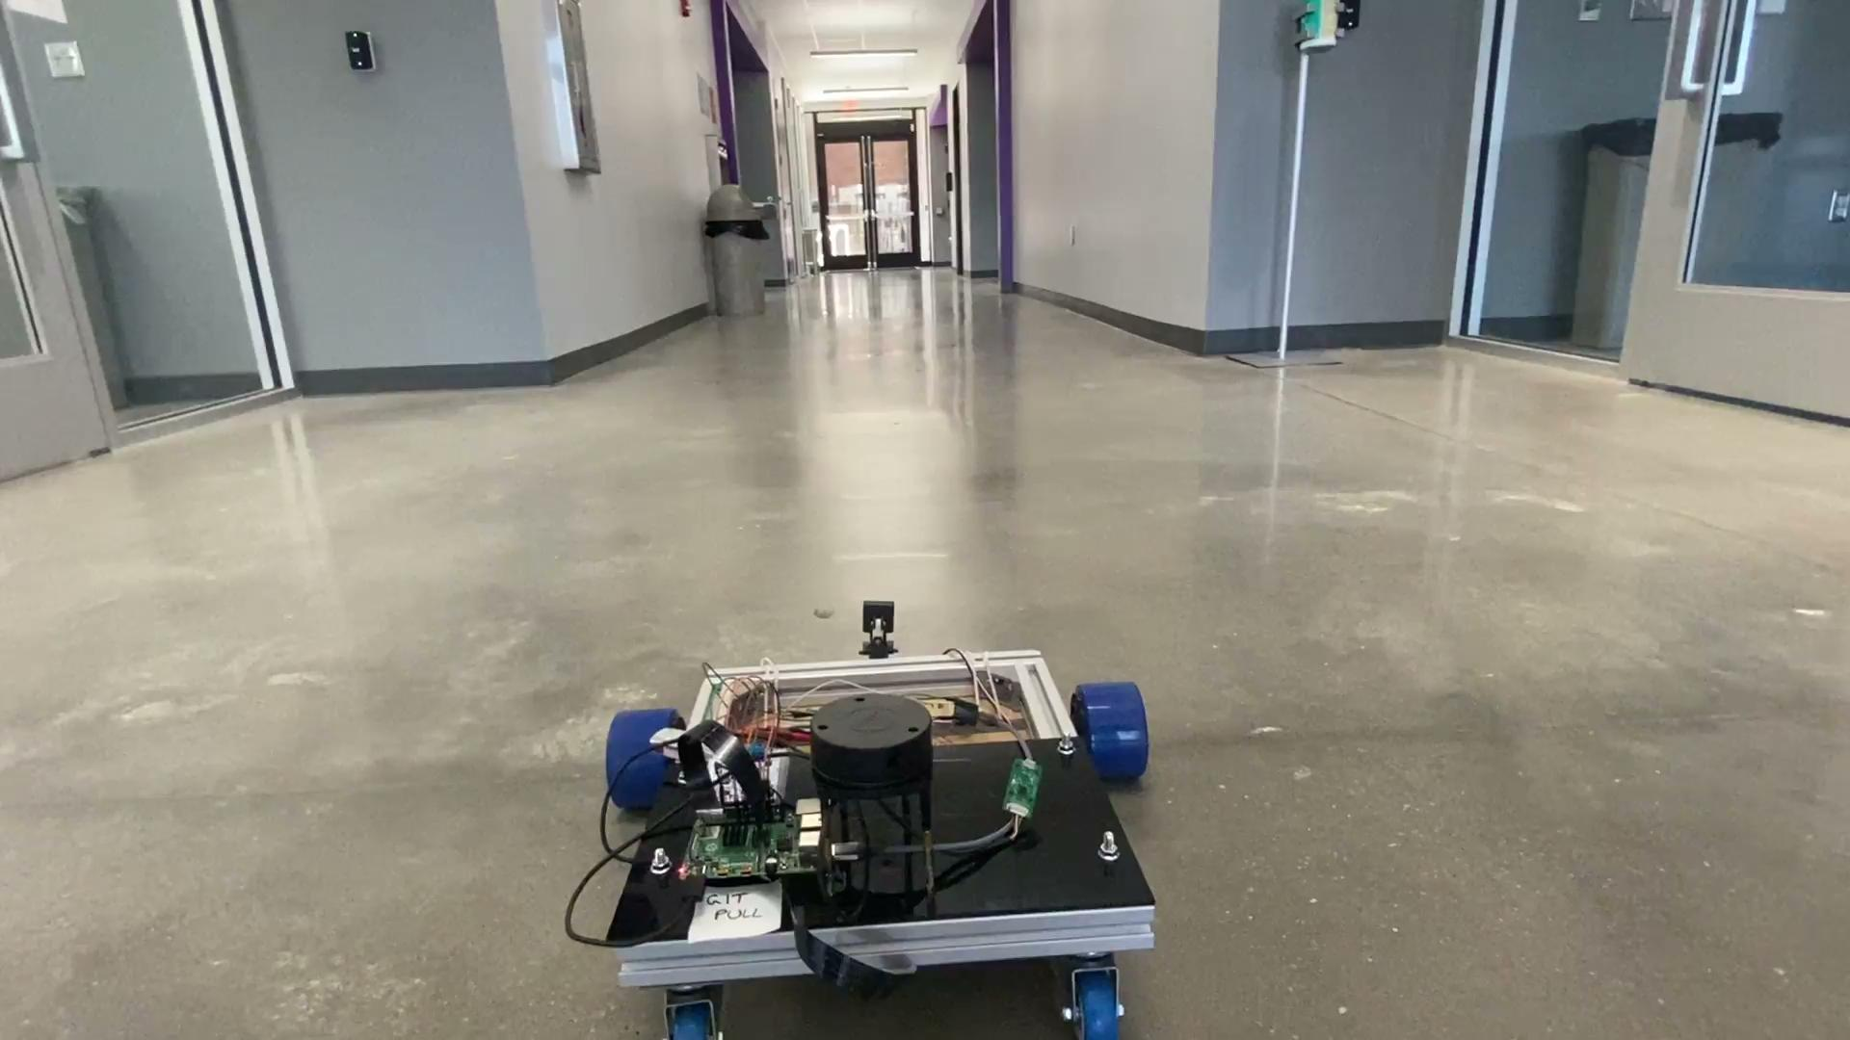

Slide 21
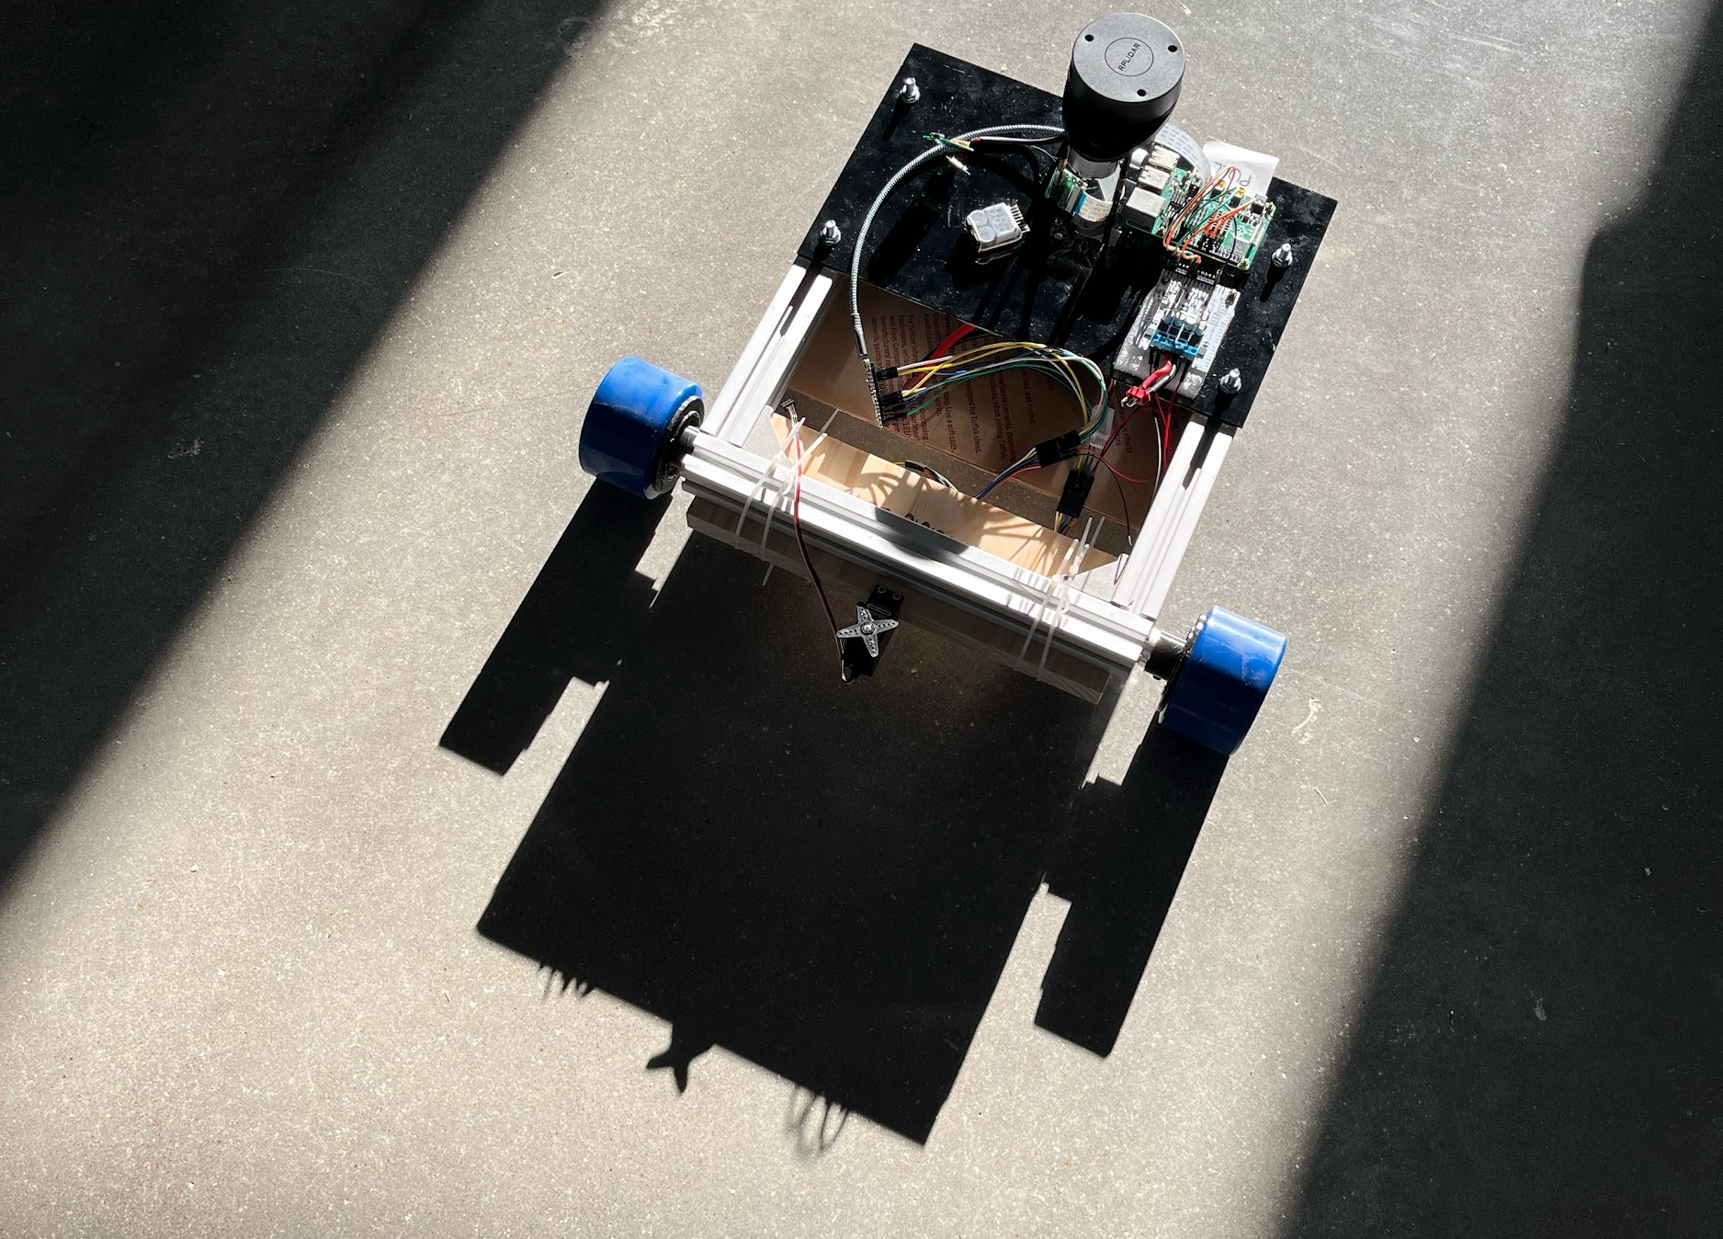
THE END

